Slide 1


Web Scraping: Extracting Car Data’s from Cars24.com
Team ‘E’

Slide 2

Our Team Members
Web Scraping -
Fathima Dilshana PK (Team Lead)
Saravanan P
Abhishek Singh
Data Cleaning and Predictive analysis Model -
Uthra Nitheya CG
Data Visualization –
Sakshi Vijay Mindhe (Co Team Lead)
Anand Eswar
Kiranbabu P
Presentation Making –
Dinesh Solanki
Project Report Making –
Mehar Snotra
Ajay Krishnan M

Slide 3

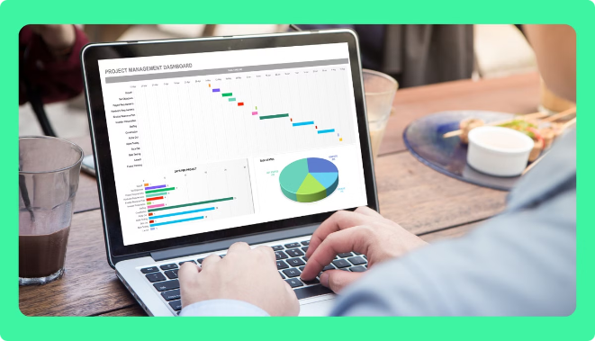
Methodology and Data Sources
Definition
Web scraping involves the automated process of extracting data from websites. It uses tools and techniques to retrieve information and convert it into a structured format for analysis.
Aim
The Moto of this project is to web scrap the car data’s from website ‘cars24.com’. Our Team ‘E’ was assigned to scrap the details of 3 branded used cars such as Mahindra, Renault and Jeep in multiple locations.
The details we needed to extract are:
Year
Make
Model
Kilometer’s driven
Ownership
Fuel Type
Transmission Type
Location
Original Price
Current Price
Tools Used
Common web scraping tools include Python libraries like requests ,Selenium and BeautifulSoup. These libraries provide functions for fetching web content, parsing HTML structures, and extracting data.

Slide 4


Project Setup and Environment
1
Install Libraries
The project begins by setting up the development environment. Essential Python libraries, including requests, BeautifulSoup, Selenium and pandas, are installed. These libraries provide the necessary tools for web scraping, HTML parsing, and data manipulation.
2
Website Inspection
Thorough inspection of the Cars24 website is crucial. This involves identifying HTML tags and classes associated with the targeted data. This step ensures that the scraper can accurately extract the desired information.
3
Scraper Development
A Python script is crafted to fetch and parse the HTML content of the Cars24 website. This script leverages BeautifulSoup to extract car details based on the identified tags and classes.
4
Data Organization and Export
The extracted data is organized into a structured format, such as a Pandas DataFrame. The data is then exported to a CSV file for further analysis and visualization.

Slide 5
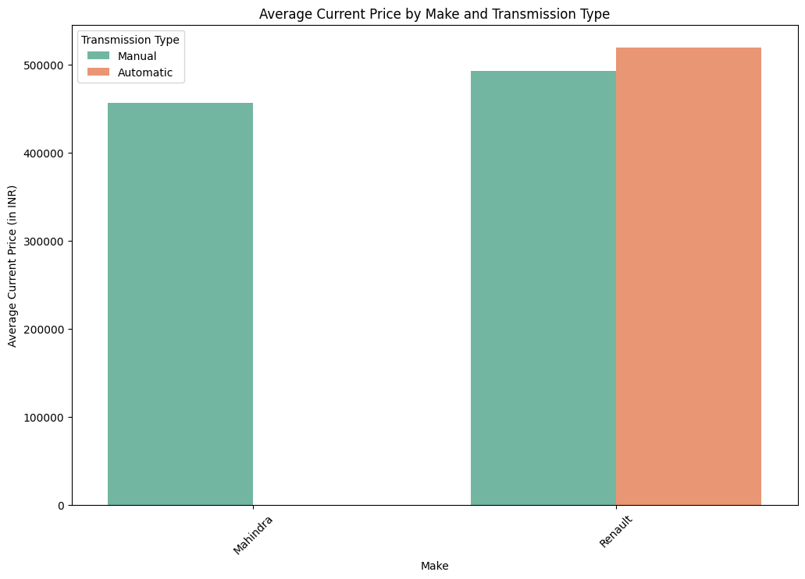

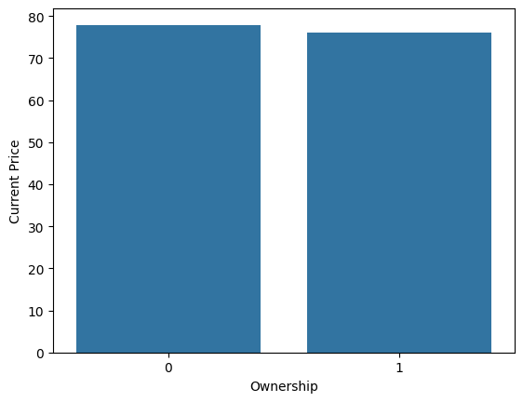

Visualizations:
We extracted details of cars for 11 locations. Based on which we visualized the following data’s.
It seems that the price of Automatic car in Renault starts above 5 Lakh and only Manual Transmission are sold from Mahindra.
Also, the ownership type plays a vital role in buying a used cars. The cars from First owner are highly purchased.

Slide 6
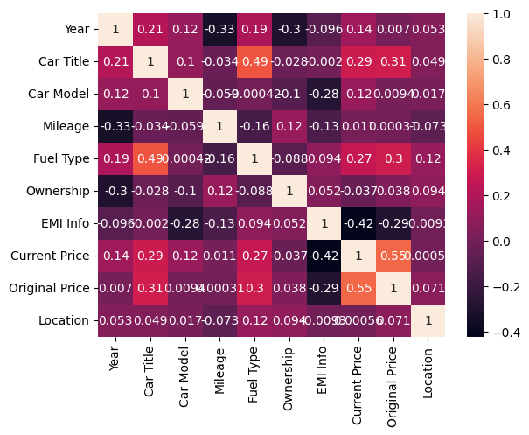
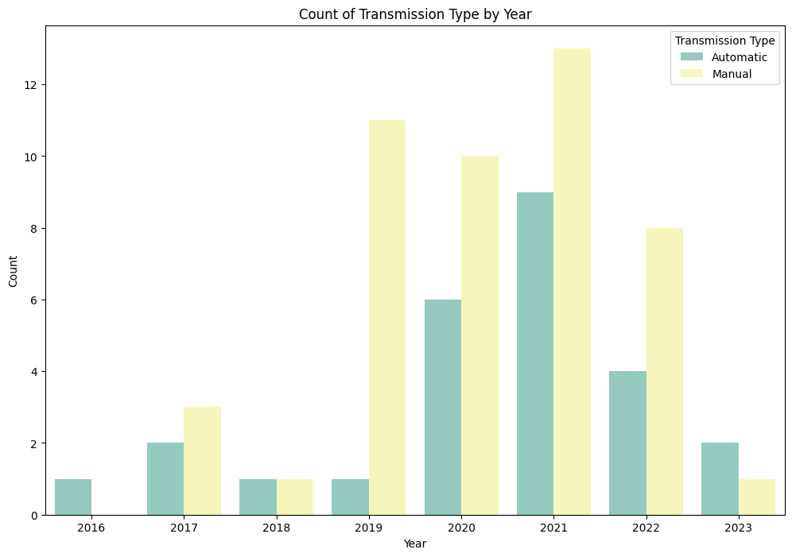
CORRELATION
The correlation matrix shows that current price is strongly correlated with original price(0.55), indicating that a car’s original price significantly impacts its current price. There are moderate correlation between car model and fuel type(0.49) and between car title and fuel type(0.49), suggesting some relationship between car characteristics and fuel type.
The maximum price of car was in the year 2021, and that for Automatic Transmission is far high.

Slide 7
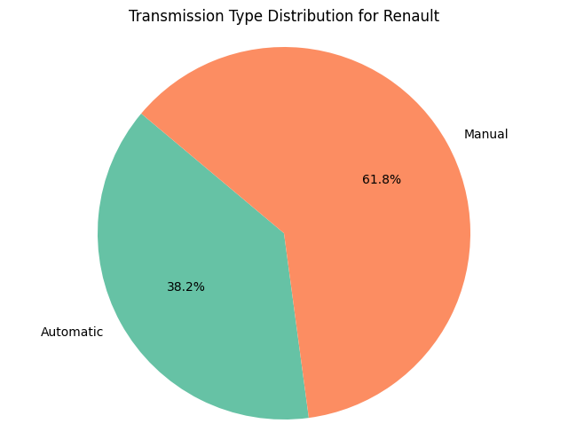
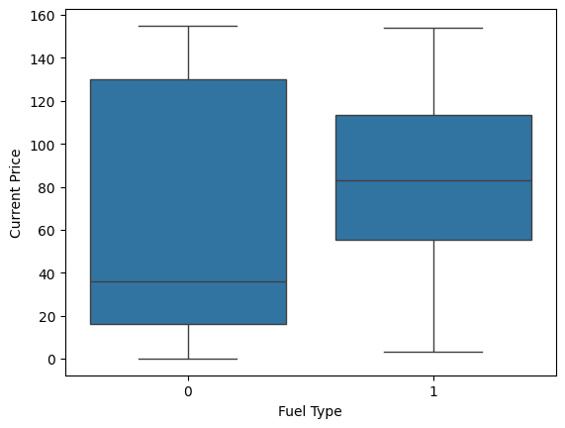
Overall the Manual Transmission cars was highly
sold in the brand Renault.
The box plot indicates the price of the car with respect to the fuel type. The ‘0’ indicates Petrol and ‘1’ indicates Diesel.

Slide 8
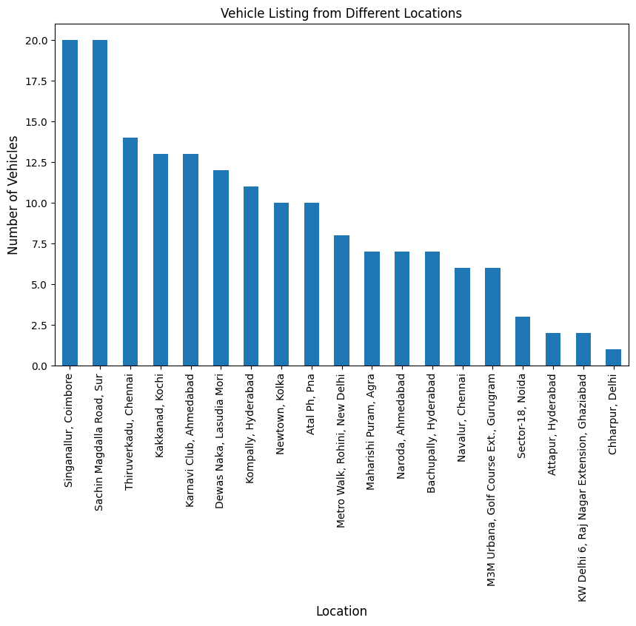
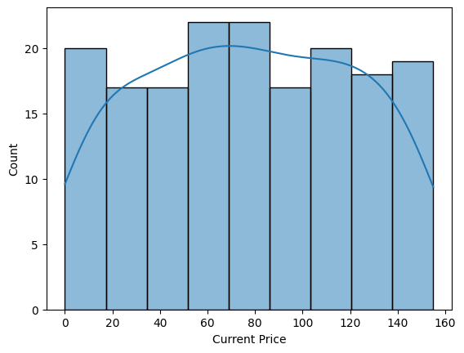
The number of vehicles available in Coimbatore and Surat are much higher than compared to other locations.
The graph shows, the costumers are buying more cars in the price range between 3.5 Lakhs to 5.5 Lakhs. The numbers 60 and 80 are mapped values of Current Price.

Slide 9
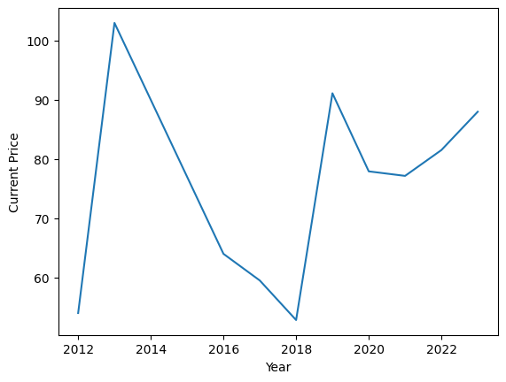
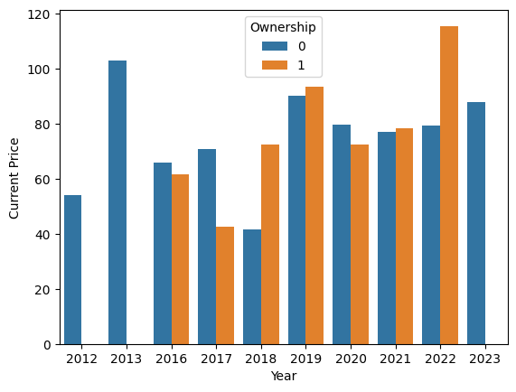
The price of 2013 modeled car was higher and lower in 2018 modeled car.
Ownership wise, the car price was higher in 2022 for 2nd owned vehicles and lower in 2018 for 1st owned vehicle.

Slide 10
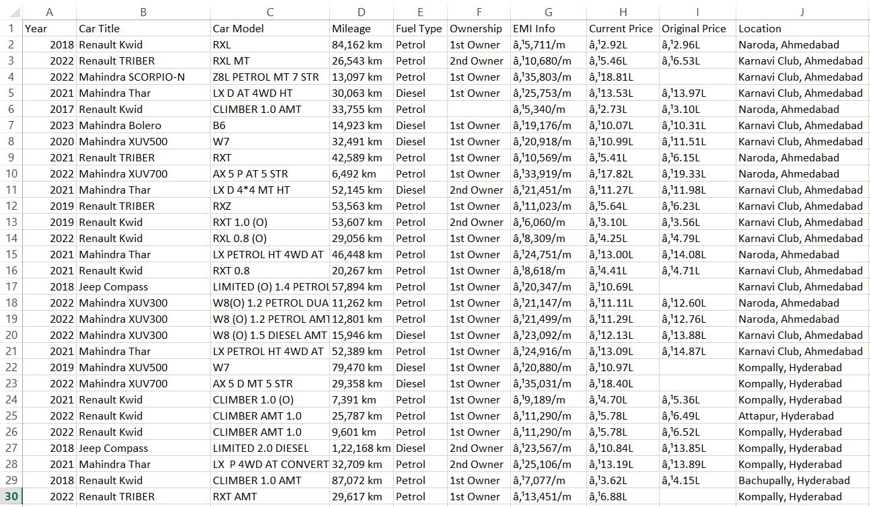
Output:- .CSV file without Data Cleaning.

Slide 11
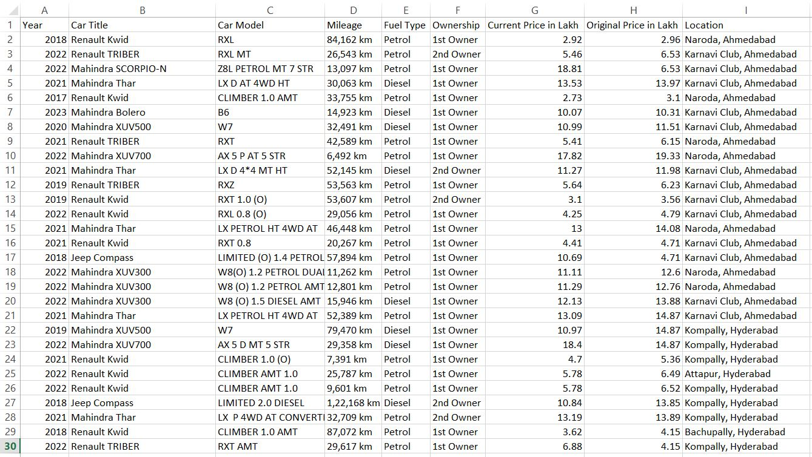
Output:- .CSV file with Data Cleaning.

Slide 12


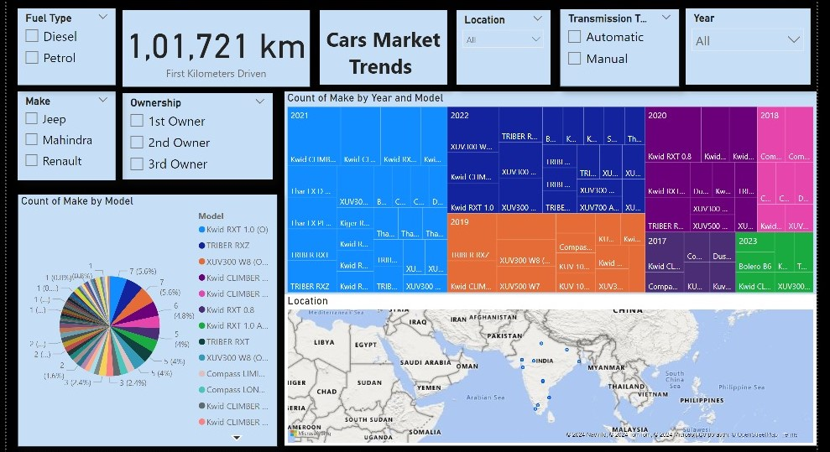
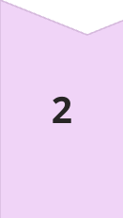

Data Analysis: Unveiling Market Trends
Data Cleaning
Before analysis, the extracted data is cleaned and processed. This involves converting data types, removing inconsistencies, and handling missing values. This ensures accurate and reliable results.
Data Visualization
Visualizing the data provides a clear understanding of trends and patterns. Histograms, scatter plots, and count plots are used to analyze the distribution of kilometers driven, year of manufacture, fuel type, transmission, and price.
Insights and Observations
Analyzing the visualized data reveals valuable insights into market trends, pricing patterns, and consumer preferences. This information can inform business decisions related to inventory management, marketing strategies, and pricing strategies.

Slide 13

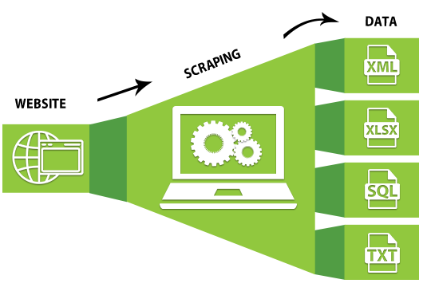
Outputs and Findings:
Efficient Scripting
Optimized scripts are developed to reduce scraping time and improve data extraction efficiency. This involves utilizing efficient algorithms, minimizing redundant code, and optimizing data processing techniques. Through this we were able to scrap the data’s of 11 Locations , such as 1. Chennai
2. Coimbatore
3. Surat
4. Kolkata
5. New Delhi
6. Patna
7. Kochi
8. Ahmedabad
9. Hyderabad
10. Indore
11. Agra
The prime factors responsible for the price differences are Ownership, Kilometers driven, Fuel Type and Transmission type. The total number of cars were seen higher in Coimbatore and Surat.
In addition , we also developed a Machine Learning Predictive analysis Script to predict the price of the car based on the values given.

Slide 14
Key Takeaways: Insights from the Data
Market Trends
Pricing Patterns
Consumer Behavior
The analysis reveals the popularity of certain Renault models, fuel types, and transmission options in Chennai and Other Location. This information helps businesses understand consumer preferences and tailor their offerings accordingly.
The data reveals pricing trends based on kilometers driven, year of manufacture, and other factors. This information can be used to set competitive prices and adjust pricing strategies to optimize profitability.
The analysis provides insights into the preferences and behavior of potential car buyers in Chennai and Other Location. Understanding consumer behavior helps businesses develop targeted marketing campaigns and enhance customer satisfaction.

Slide 15


Challenges in Web Scraping
1
Dynamic Content
Websites often utilize JavaScript and other technologies to dynamically load content. Handling dynamic content poses a challenge, as traditional scraping methods may not capture the complete information.
2
Request Limits
Web scraping should be conducted responsibly to avoid overwhelming websites with excessive requests. Websites often implement rate limits to protect their resources and prevent abuse.
3
Legal and Ethical Guidelines
Web scraping must adhere to legal and ethical guidelines. It's essential to respect website terms of service, robots.txt files, and privacy policies. Avoid scraping sensitive data or engaging in activities that could harm websites or their users.
4
Data Cleaning and Validation
The scraped data may contain inconsistencies, errors, or missing values. Data cleaning and validation processes are crucial to ensure the accuracy and reliability of the extracted information.

Slide 16
Conclusion: Harnessing Data for Informed Decisions
This web scraping project demonstrates the power of data extraction and analysis. By leveraging Python libraries and techniques, valuable insights into the automotive market are extracted from Cars24. These insights empower businesses to make informed decisions related to pricing, inventory management, and marketing strategies, ultimately leading to enhanced profitability and customer satisfaction.
Applications:
Web scraping has diverse applications, including data mining, market research, price monitoring, and competitive analysis. It enables businesses to gain valuable insights from publicly available online data.

Slide 17
Thank You

